Slide 1
Environmental Noise No Longer Relevant for Speech Recognition.
Adithya M.R. Padala – President & CEO – UmeVoice Inc.
www.theBoom.com

Slide 2
Introduction
Umevoice founded in 1995
Focused on voice recognition for trading
Customers:
Typical statement “IBM offer 1 million at 128.99”
Typical sale: $1 M+ for 20 users

Slide 3
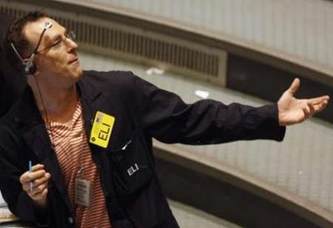
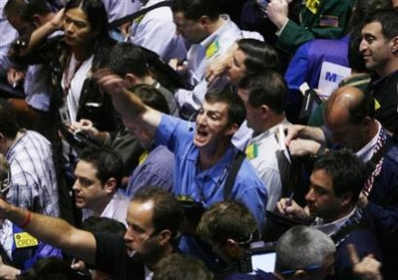
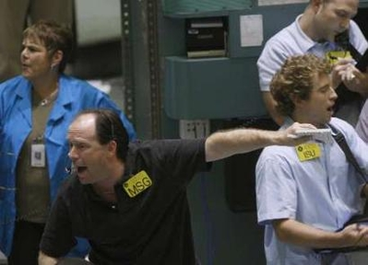
Serendipitous Invention
Trading rooms are noisy places
Exchange floors are much noisier
Babble noise is much tougher than other noise to eliminate
We accidentally invented noise canceling technology!

Slide 4
The World’s Best Noise Canceling Headsets
Notes:
Click the video and it will play full screen. To pause the movie simply click anywhere and to resume playing click again. When the movie is done it will auto rewind and the slide will revert back to it’s initial state.

Slide 5
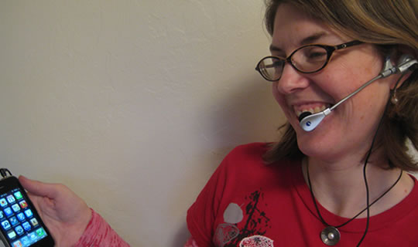
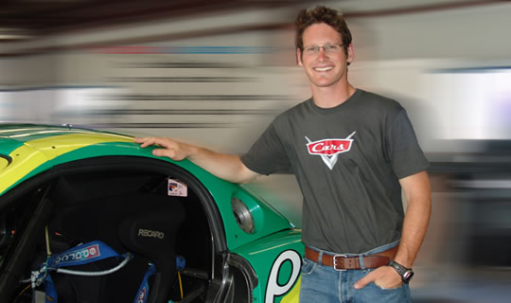
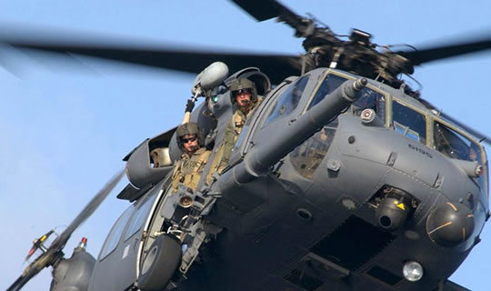
Transforming the Company
Million $ customer - $100 customer
Creation of multiple products from one
Creation of multiple markets: Consumer, Military, Fortune 500 Companies, Racing
The internet

Slide 6
Speech Applications That Have Come Our Way
Consumer:
Voice dialer, Voice search, Dictation
Wall Street:
Looks, Entering Trades, Queries
Military:
Speech apps on laptops in Humvees, Translation, Flight lines
Industrial:
Voice picking, Quality assurance

Slide 7
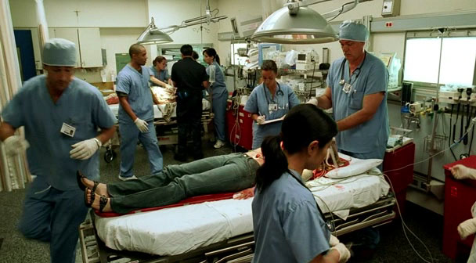
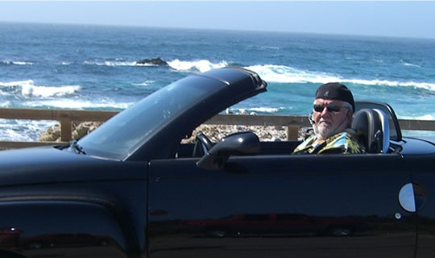
Other Environments where our technology has been effective
Emergency rooms
Legal applications
In the car
On the beach

Slide 8
Where There’s Noise There’s an Opportunity
Most people have stayed away from speech apps
Technologically this is no longer a problem
Focus on the creation of value
Consumer, Wall Street, Military, Nascar, Industrial

Slide 9
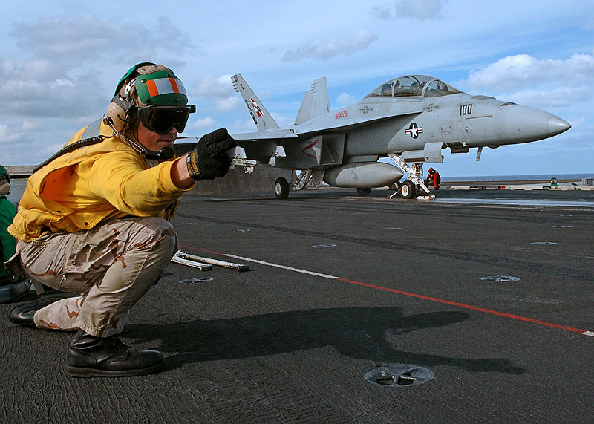
Summary
Noise a non issue
If your environment is really noisy speech apps can still work fine
Focus on the value to the customer
Plenty of opportunity

